Slide 1


Slide 2
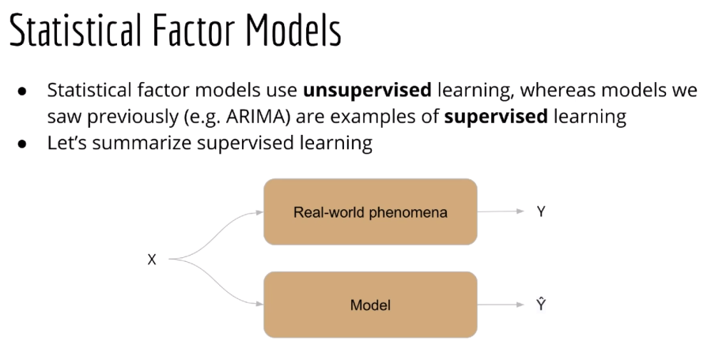

Slide 3
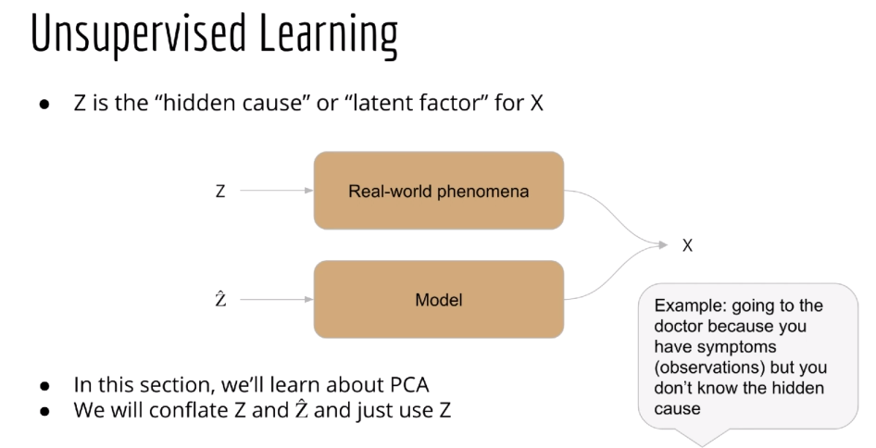

Slide 4
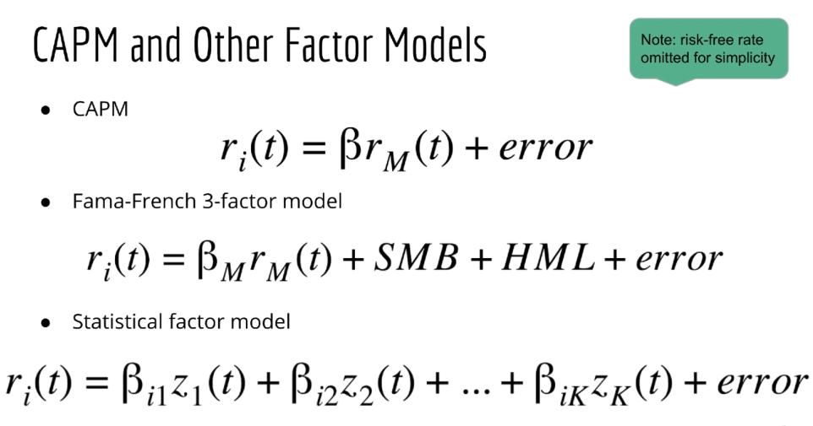

Slide 5
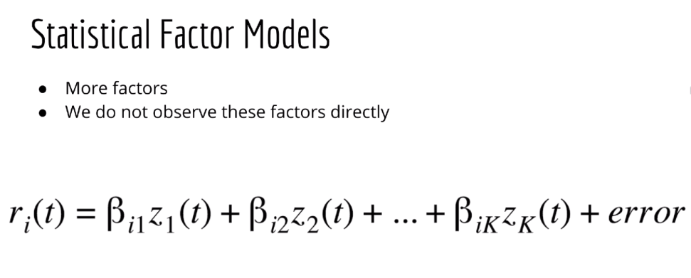

Slide 6
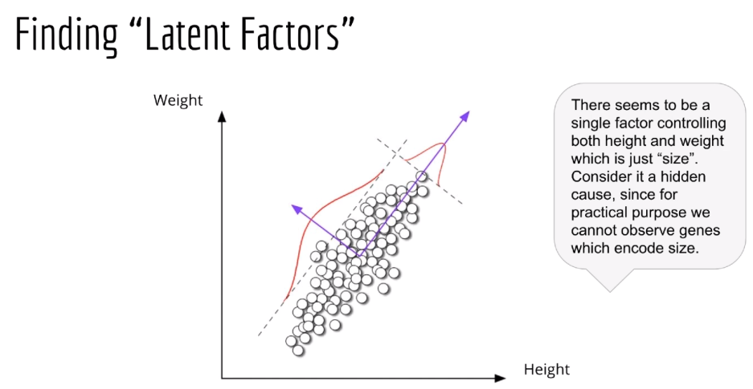

Slide 7
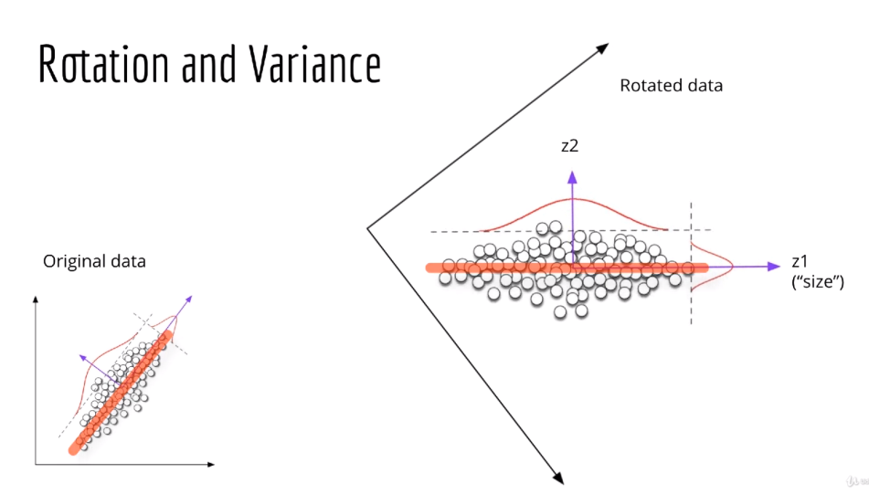

Slide 8
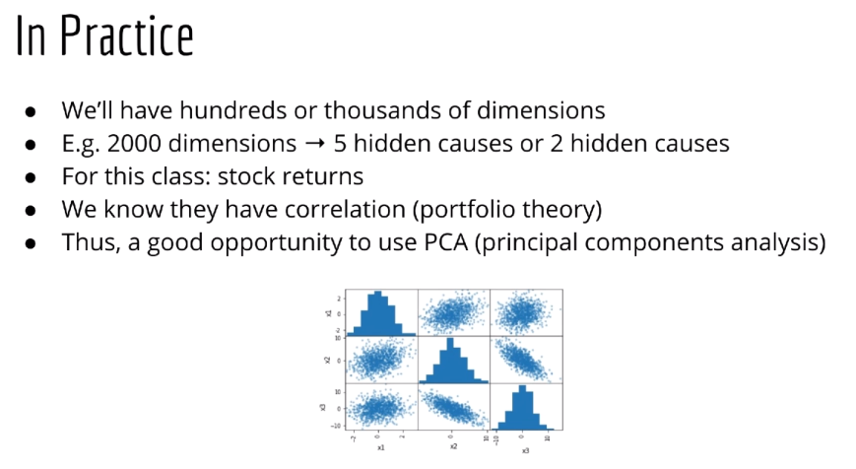

Slide 9
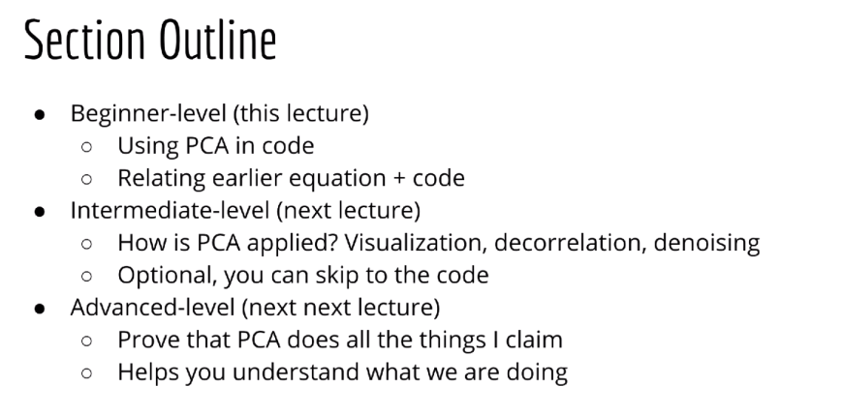

Slide 10
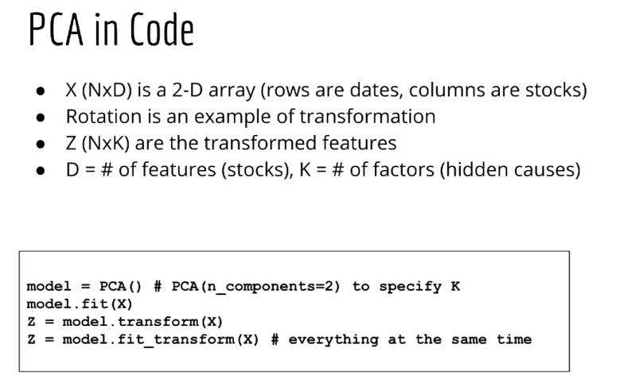

Slide 11
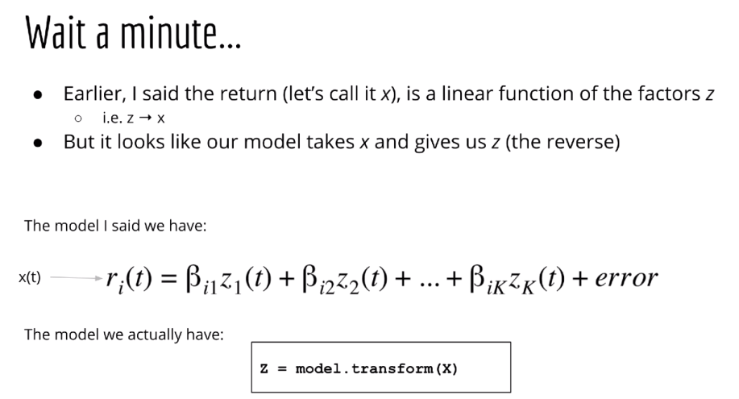

Slide 12
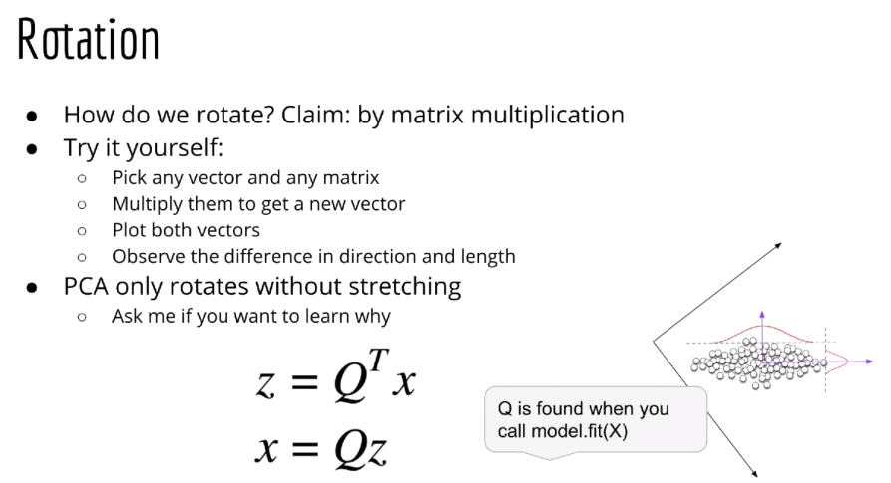
Because the Q matrix is orthonormal.. ||Q|| = 1

Slide 13
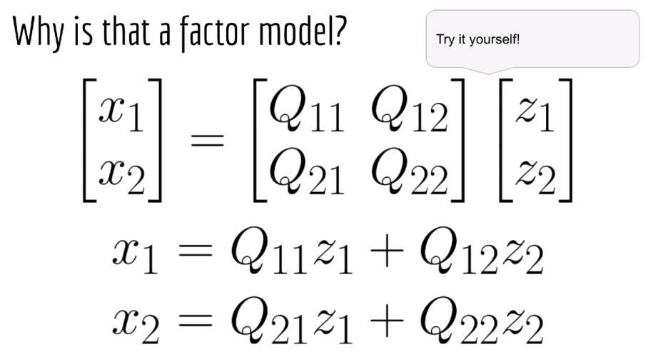
X1 is stock 1, X2 is stock 2, they are derived by latent variable of z1, and z2

Slide 14
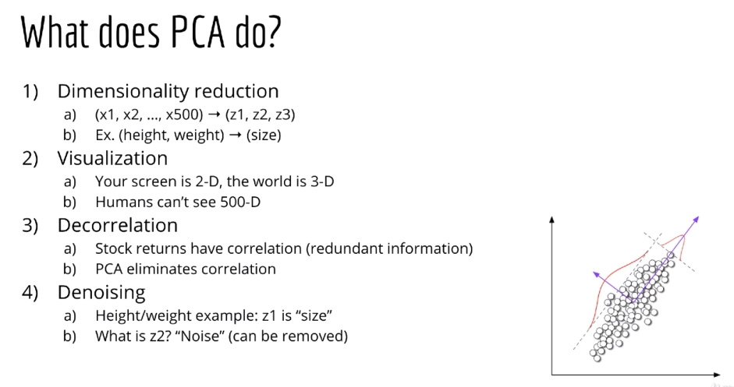

Slide 15
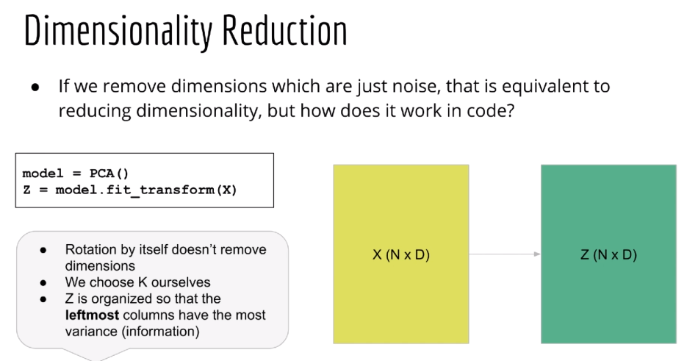

Slide 16
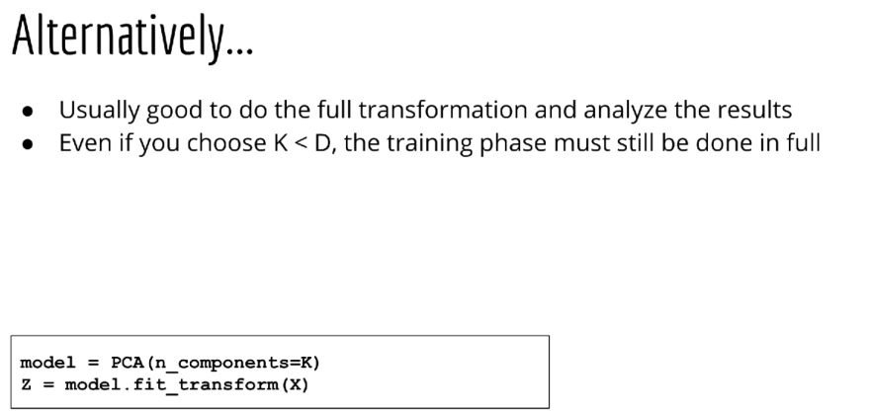

Slide 17
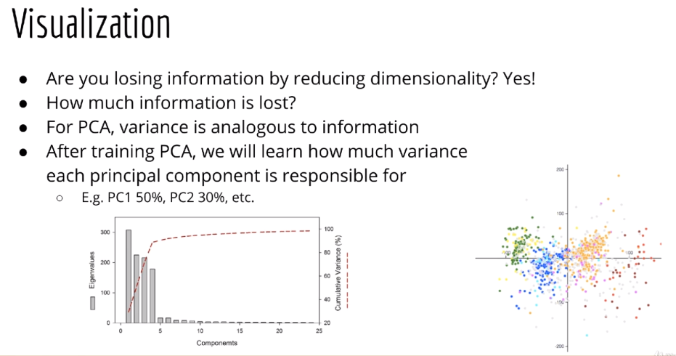

Slide 18
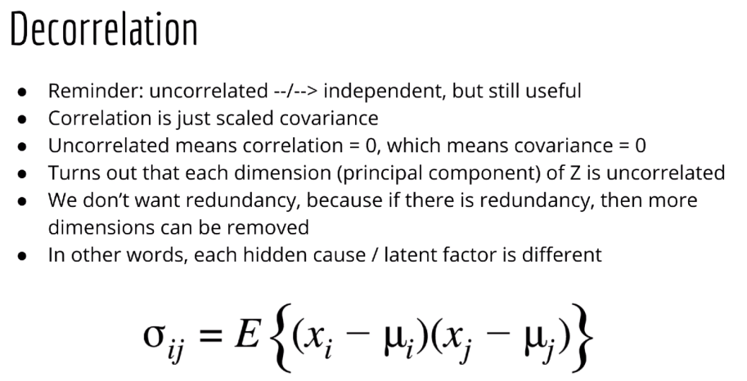

Slide 19
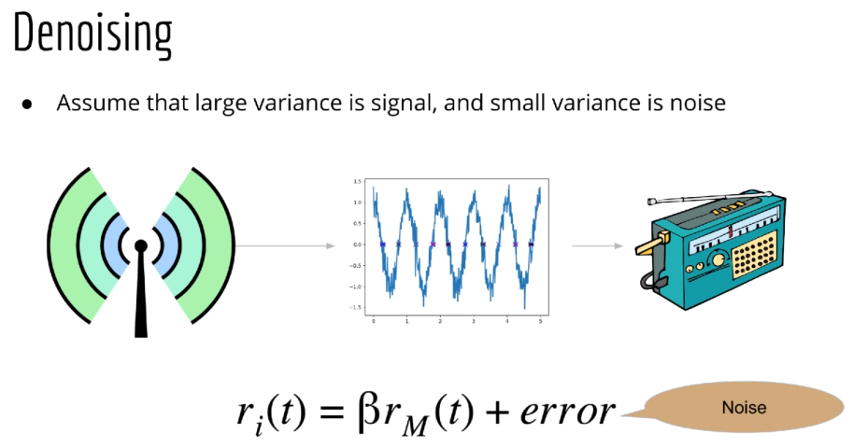

Slide 20
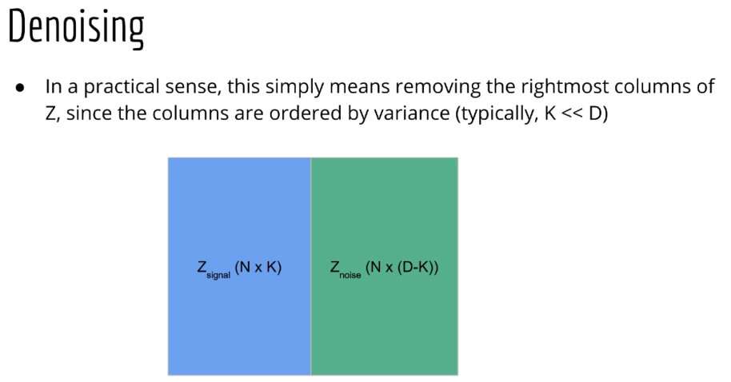

Slide 21
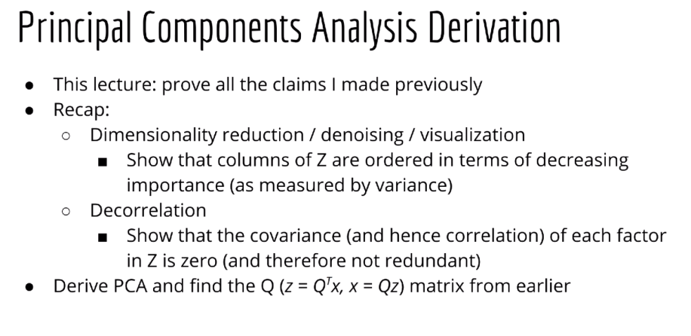

Slide 22
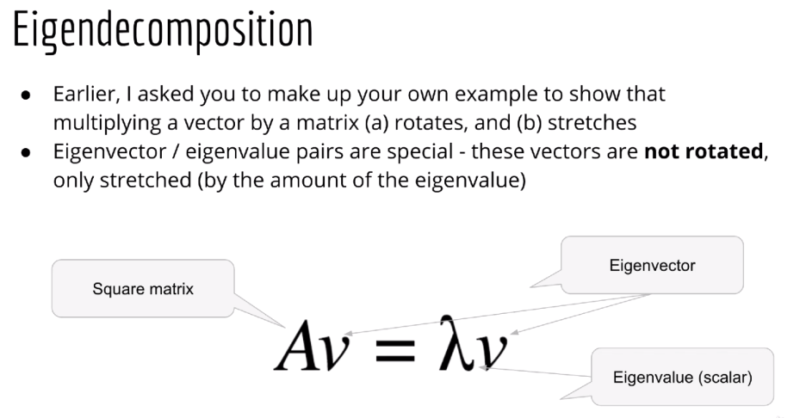

Slide 23
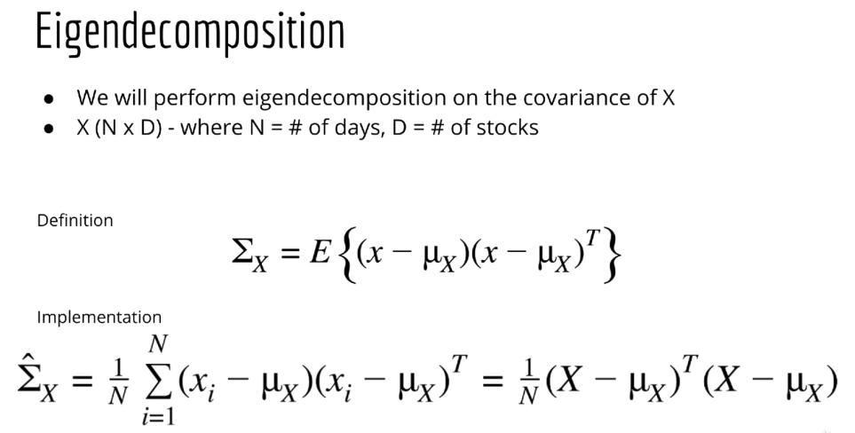

Slide 24
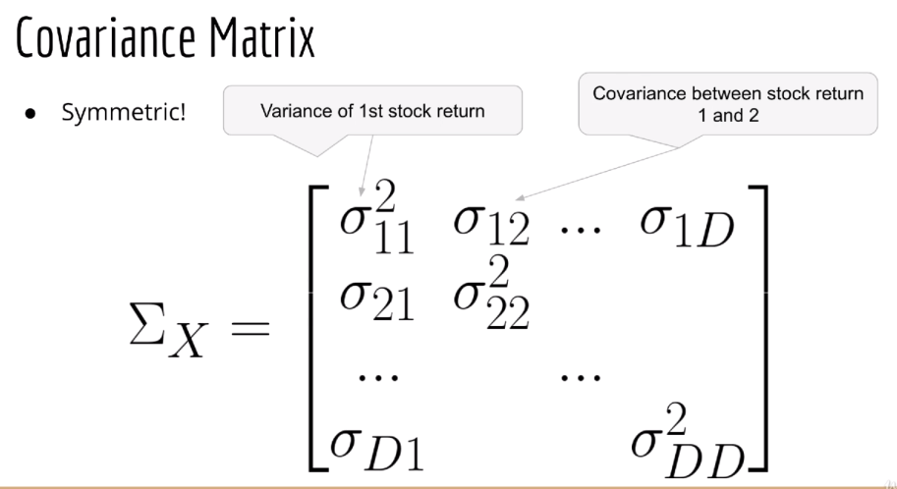

Slide 25
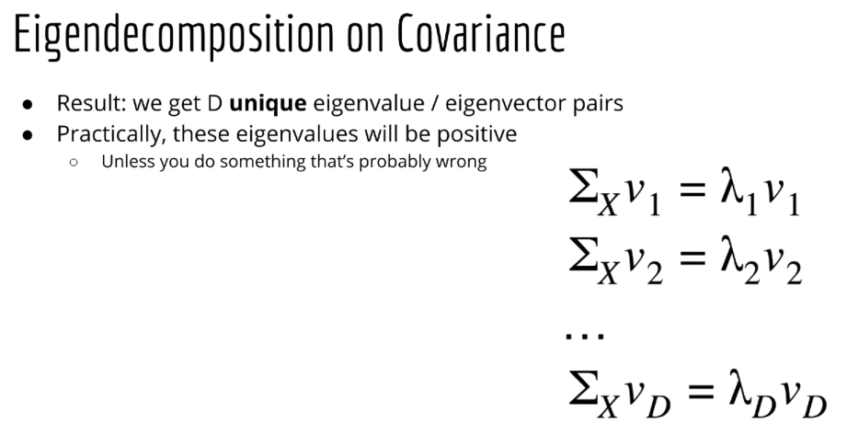

Slide 26
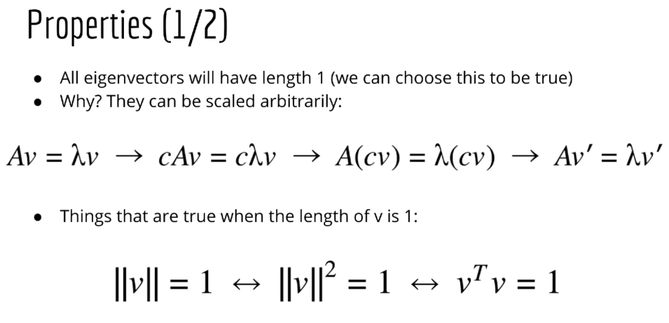

Slide 27
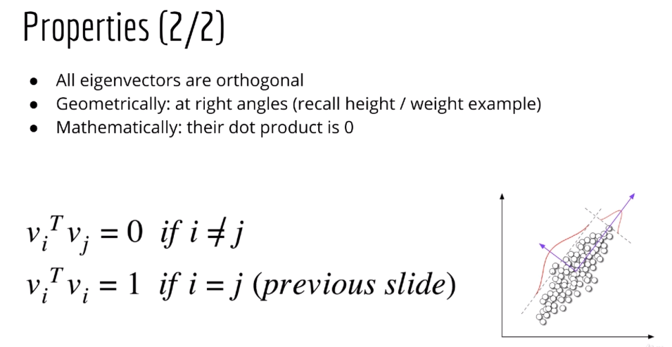
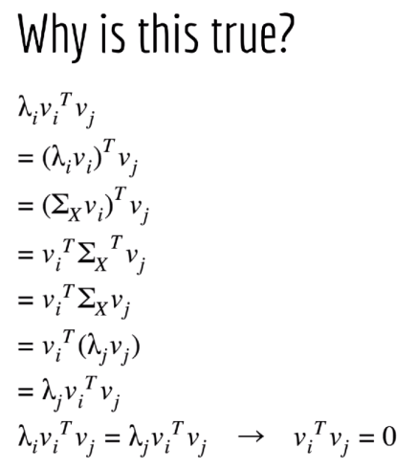

Slide 28
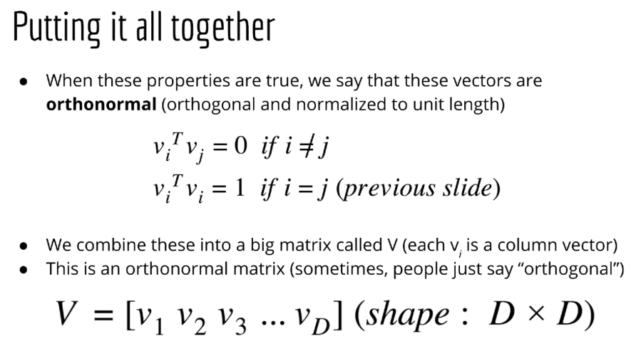

Slide 29
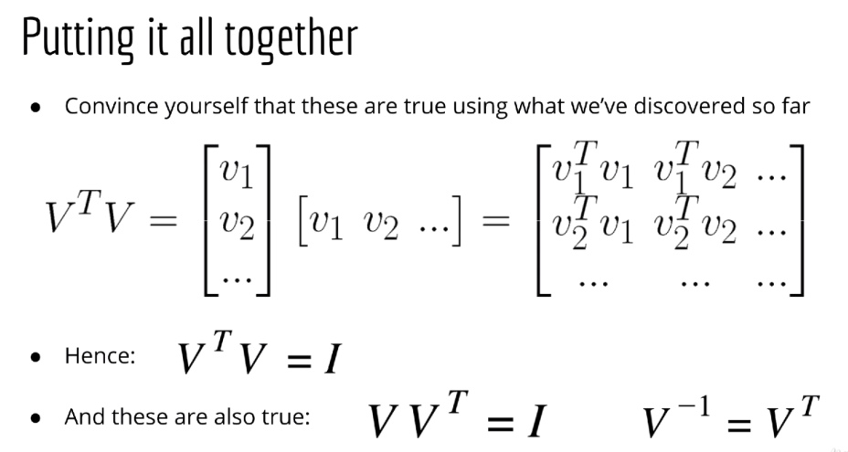

Slide 30
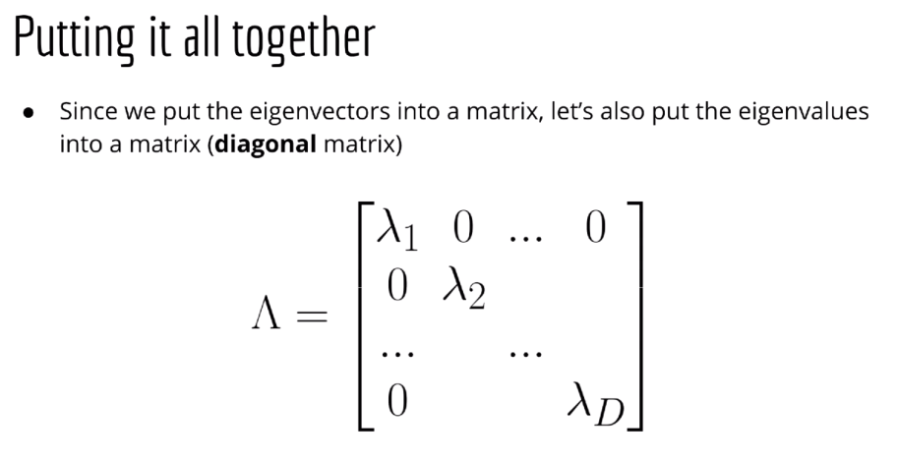

Slide 31
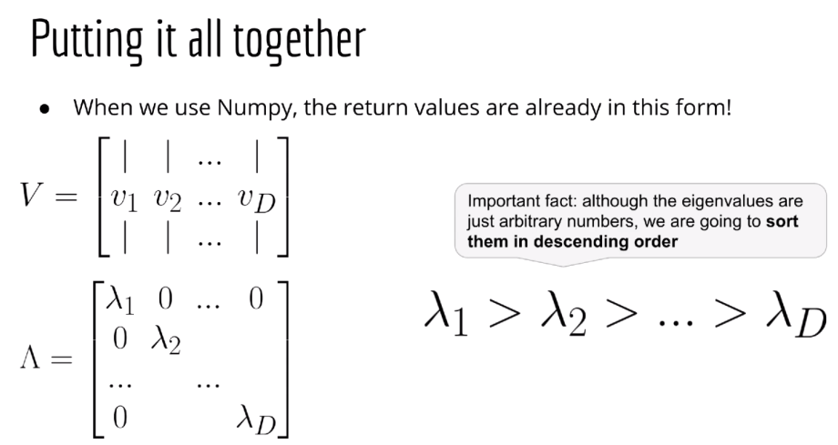

Slide 32
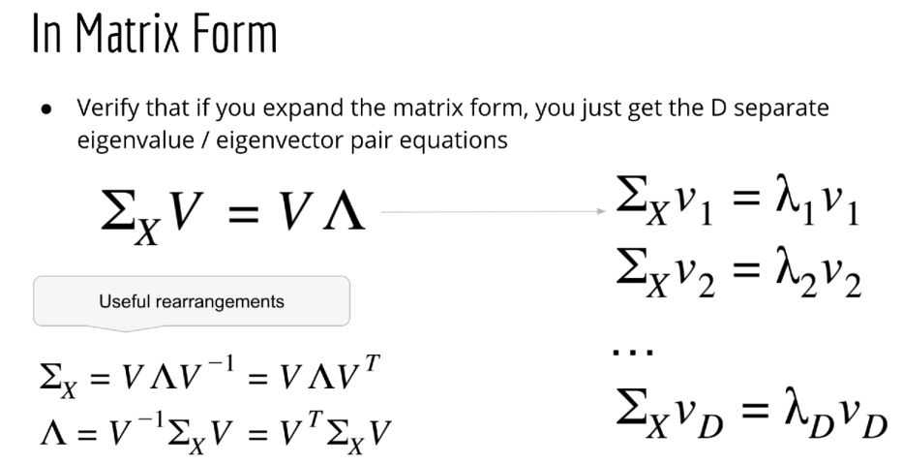

Slide 33
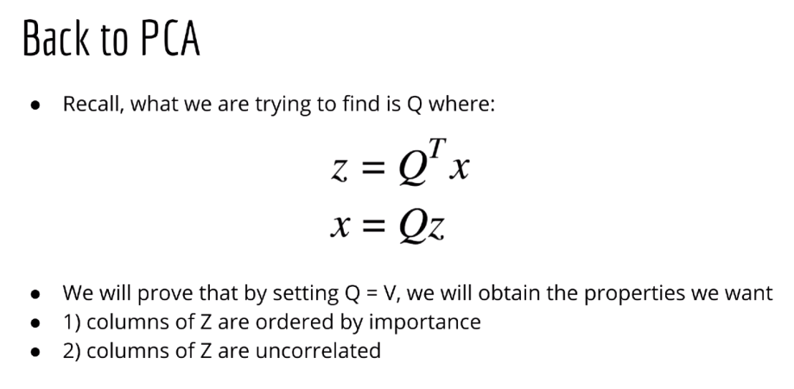

Slide 34
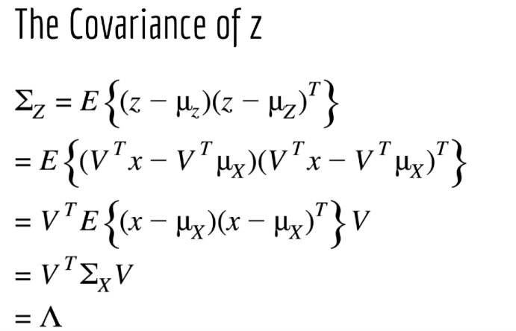

Slide 35
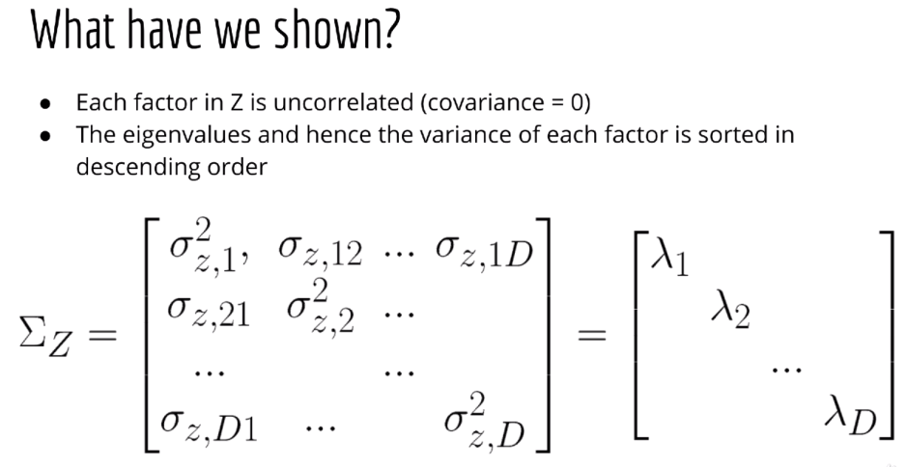

Slide 36
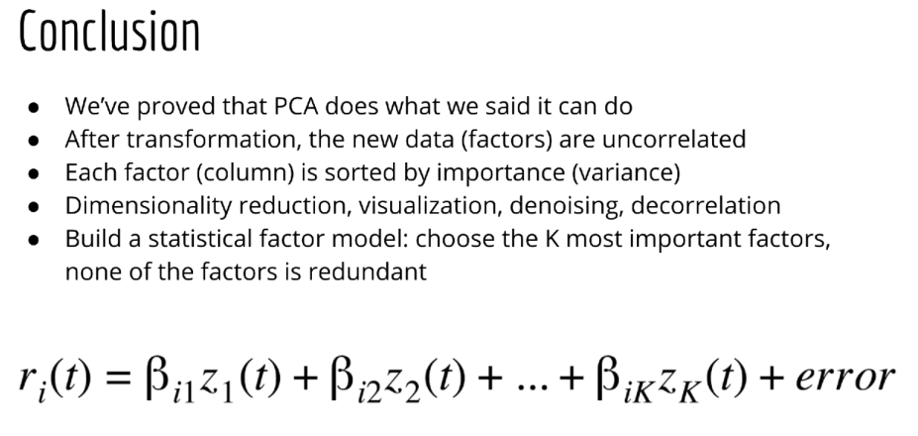

Slide 38
Sequential model

Slide 39
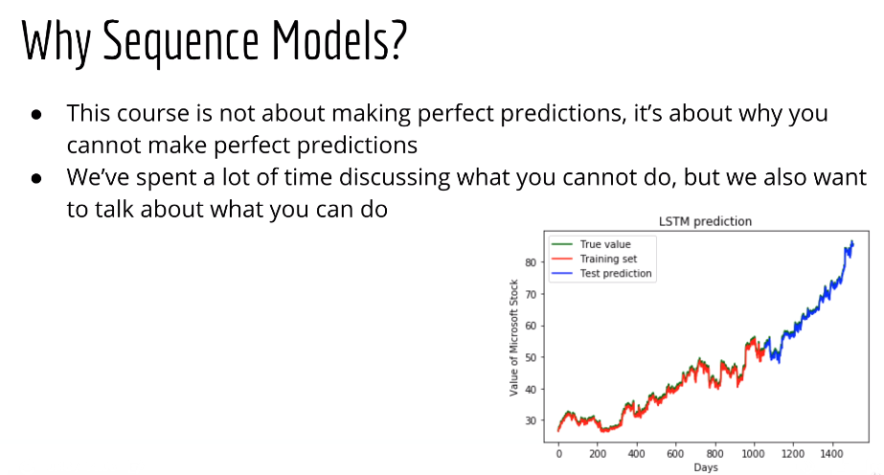

Slide 40
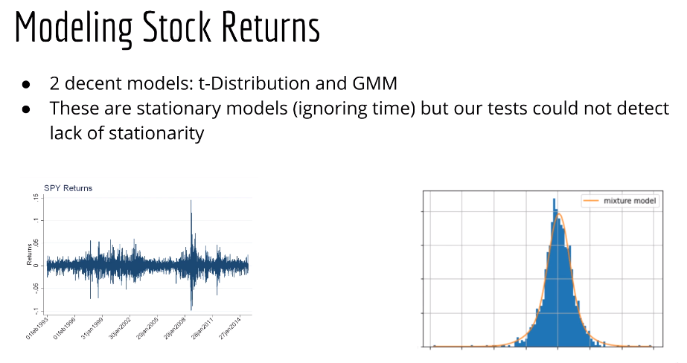
We need a framework to model time dependent volatility (non-stationary )
e.g. HMM

Slide 41
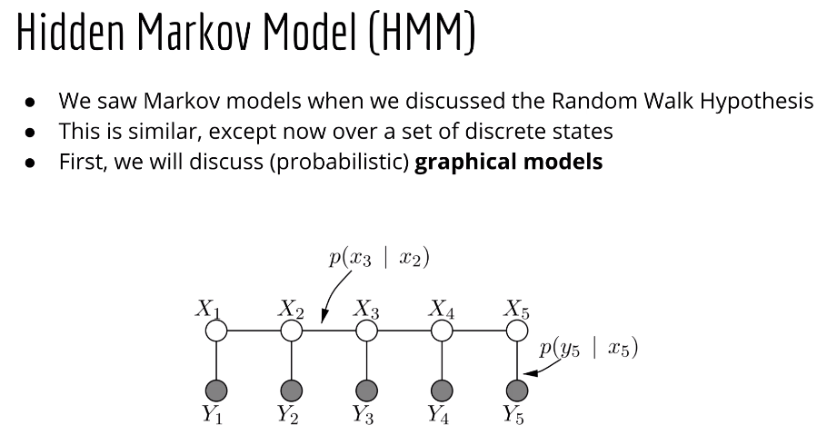

Slide 42
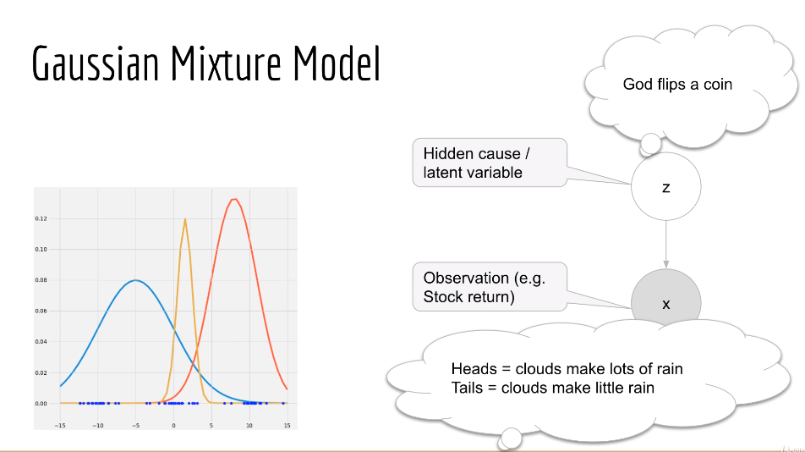
Shade: obversed
Non-shaded: latent variable. Non-observable

Slide 43
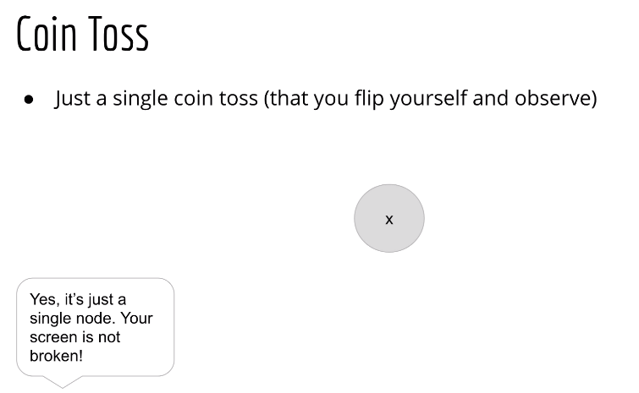

Slide 44
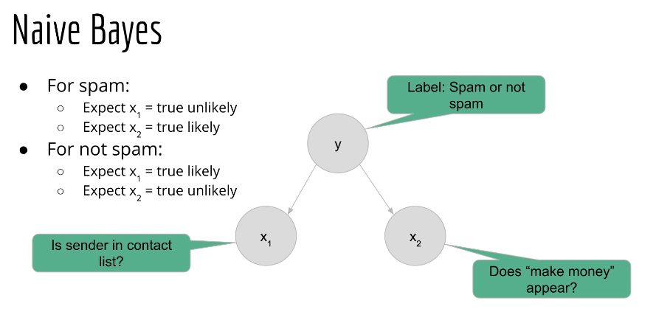
Naïve: Everything is observed

Slide 45
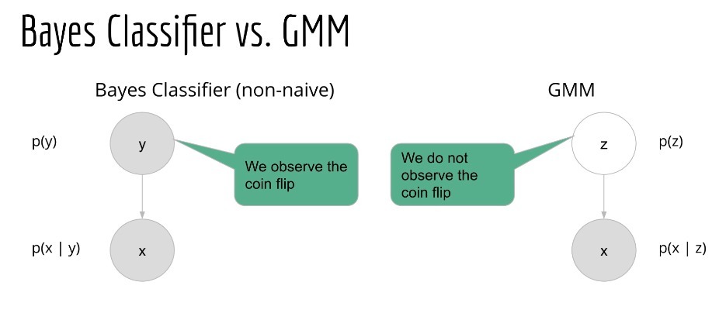
Direction of inference is the direction of arrows
Shaded is observed, non-shaded is hidden
Nodes without arrow, will be marginal prob
Nodes with arrows in, will be conditional prob

Slide 46
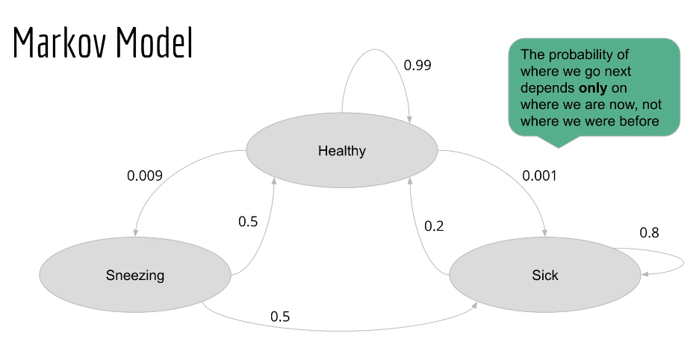

Slide 47
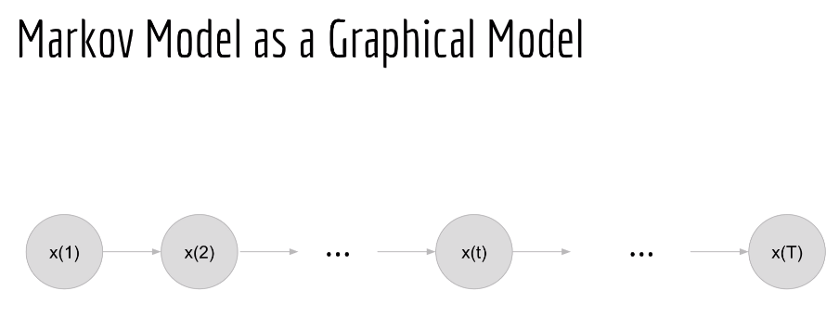

Slide 48
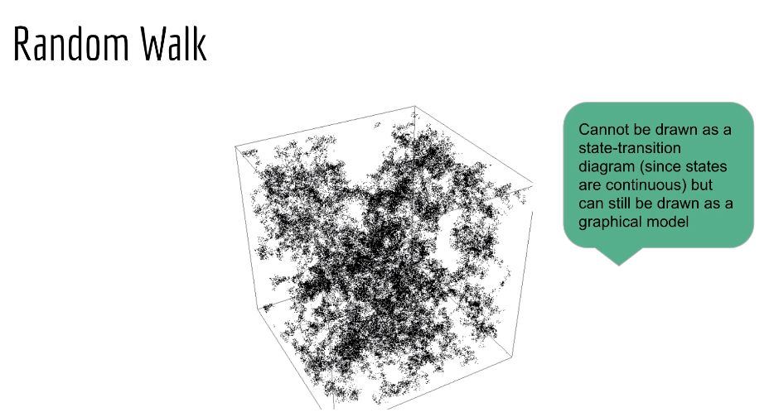

Slide 49
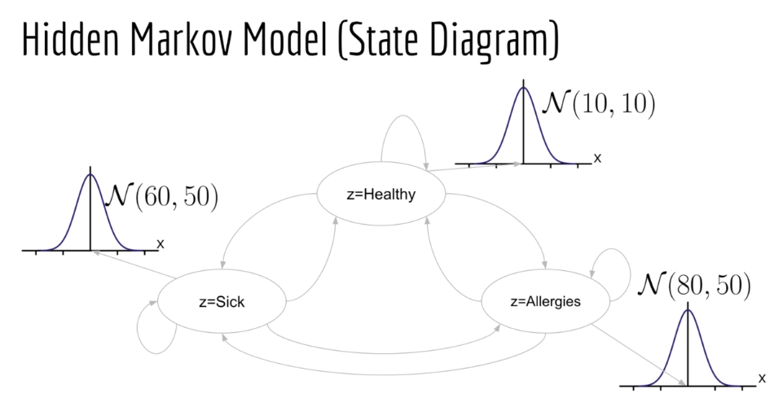

Slide 50
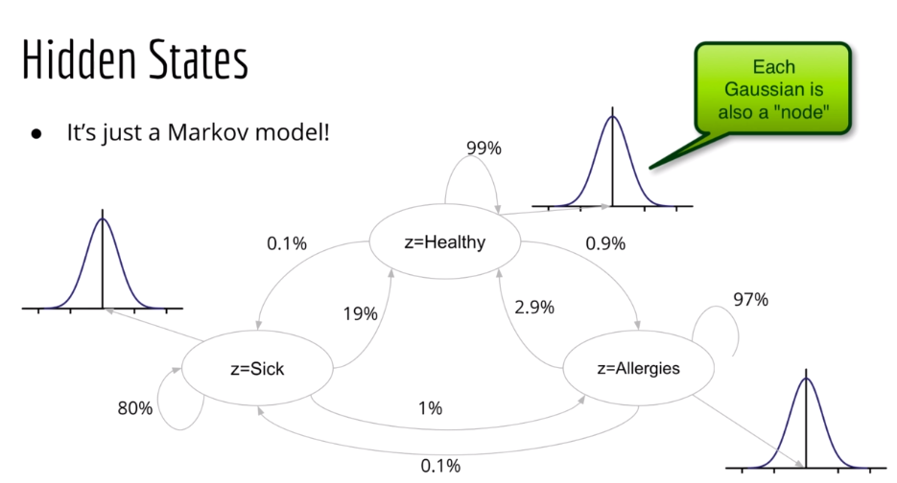

Slide 51
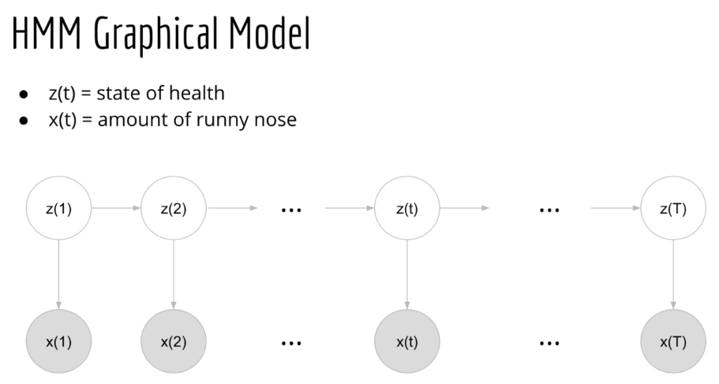

Slide 52
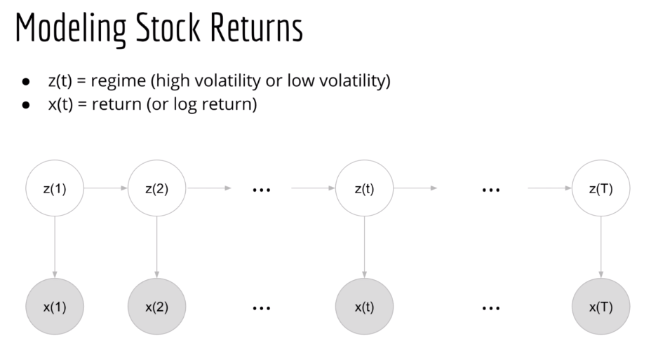

Slide 53



Slide 54


Slide 55


Slide 56


Slide 57


Slide 58


Slide 59


Slide 60



Slide 61


Slide 62


Slide 63


Slide 64


Slide 65


Slide 66


Slide 67


Slide 68


Slide 69


Slide 70


Slide 71


Slide 72


Slide 73


Slide 74


Slide 75



Slide 76


Slide 77


Slide 79

Treat the covariance matrix as diagnose matrix
Our example is single variable also.. So, it is diag

Slide 83


Slide 84


Slide 85


Slide 86


Slide 87


Slide 88


Slide 89


Slide 90


Slide 91


Slide 92


Slide 93


Slide 94


Slide 95


Slide 96
Colab notebook
https://docs.google.com/document/d/1xP4Hx4G_BraIGKKwWDL6DamIOUEI--6OuuSQZlFPeNU/edit

